Slide 1

Git Version Control System
by
Chaithra TV
Vidyalaxmi Shenoy
Vijayalakshmi Kamath
03-Jan-14

Slide 2

Contents
Introduction
Git as DVCS
The Three States
File Status Life Cycle
Fork and Clone
Commit
Branching
Merging
Collaborator
Push, Pull and Sync

Slide 3
Introduction
Git is a distributed version control system and source code management system with emphasis on speed.
Every git working directory is a full fledged repository with complete history and full version tracking capabilities, not dependent on network access or central server.
Git supports rapid branching and merging, and includes specific tools for visualizing and navigating a non linear development history.

Slide 4
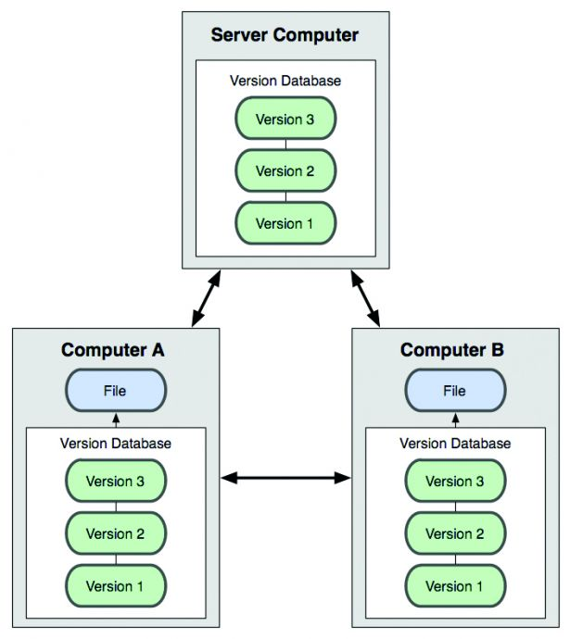
Git as DVCS
Client fully mirror the repository instead of just checking out the latest snapshot of files.
Fig. 1: Distributed Version Control Diagram

